Slide 1
Sinapsis - Neurotransmisores
Nelson D. Villalba M.D. M.Sc.

Slide 2
¿Qué es la SINAPSIS?

Slide 3
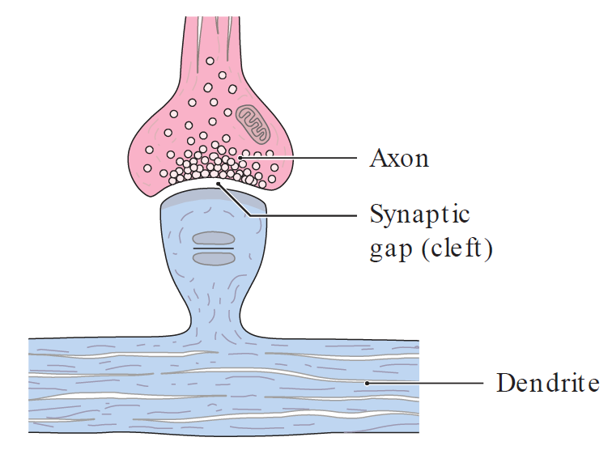
Sinapsis

Slide 4
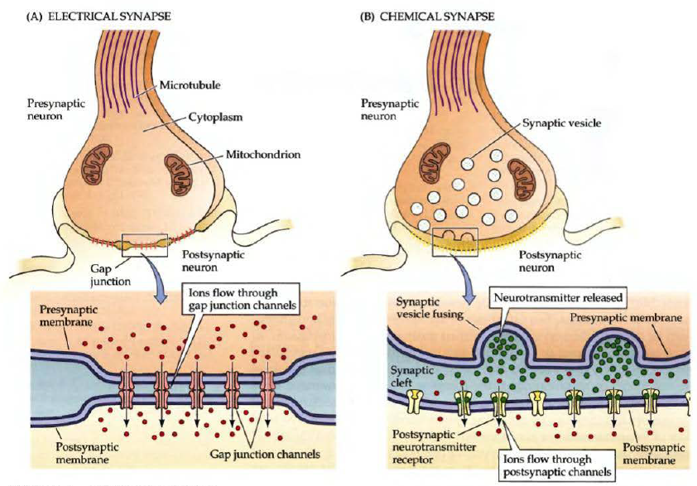

Slide 5
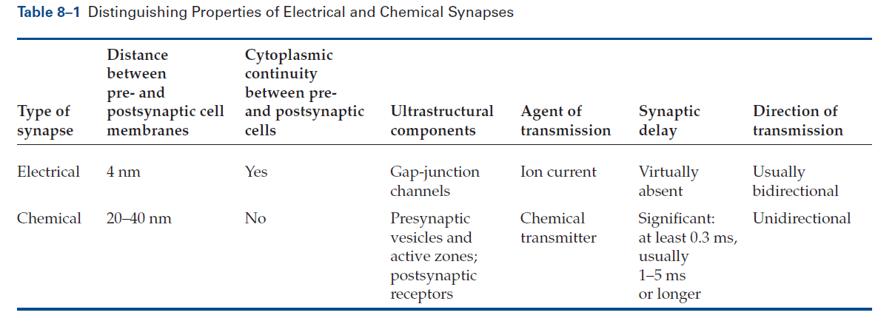

Slide 6
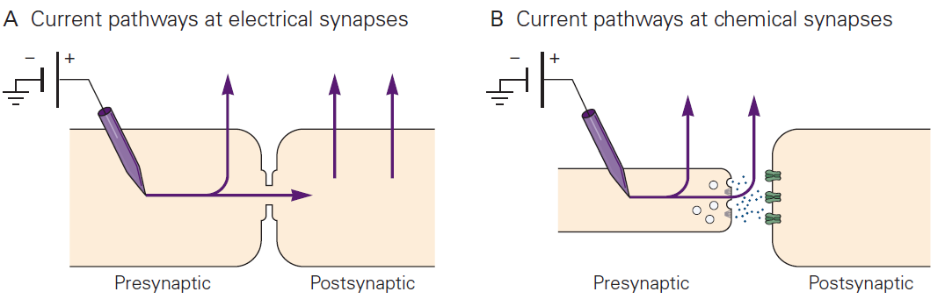

Slide 7
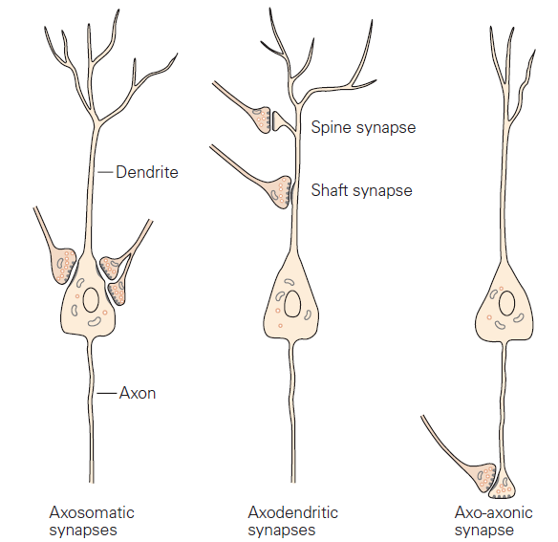

Slide 8
Sinapsis Eléctrica

Slide 9
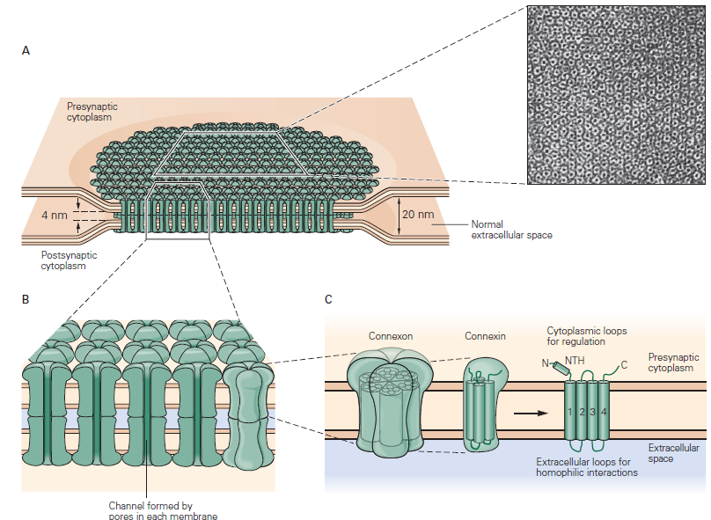
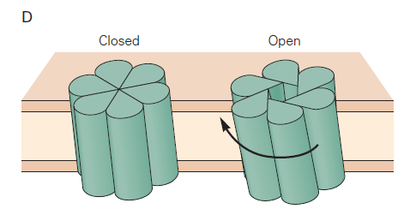

Slide 10
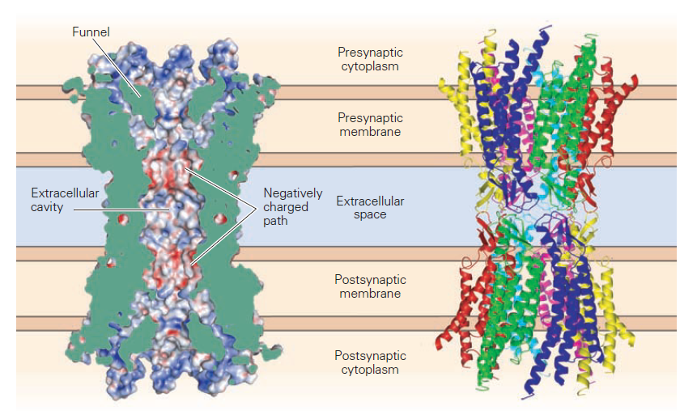

Slide 11
Sinapsis Química

Slide 12
Síntesis/
Almacenamiento
Liberación
Interacción con el receptor
Reciclaje

Slide 13
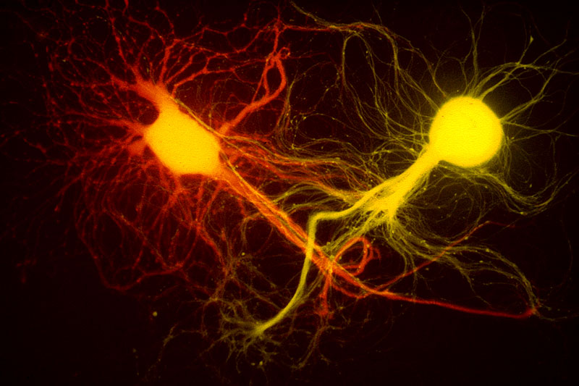
Sinapsis Química
here.

Slide 14
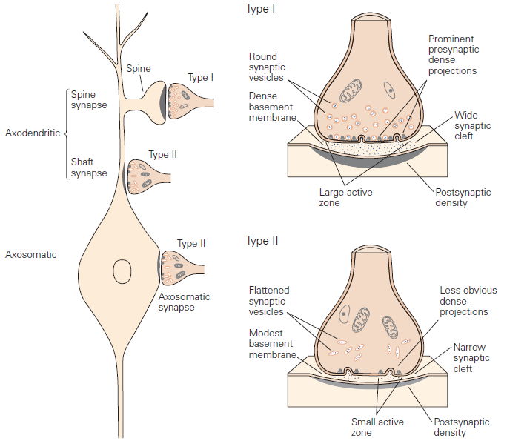

Slide 15
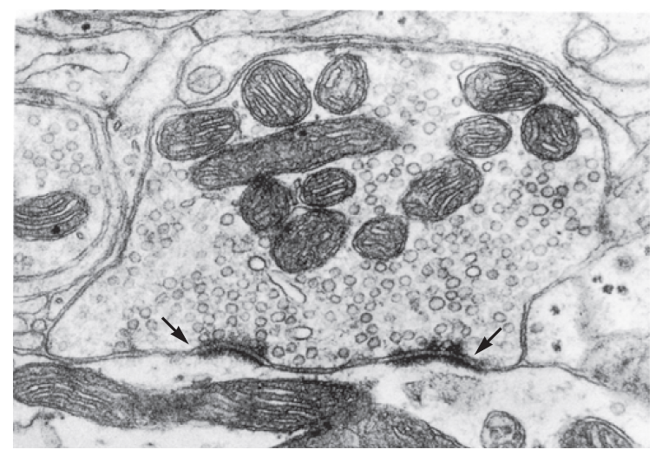

Slide 16
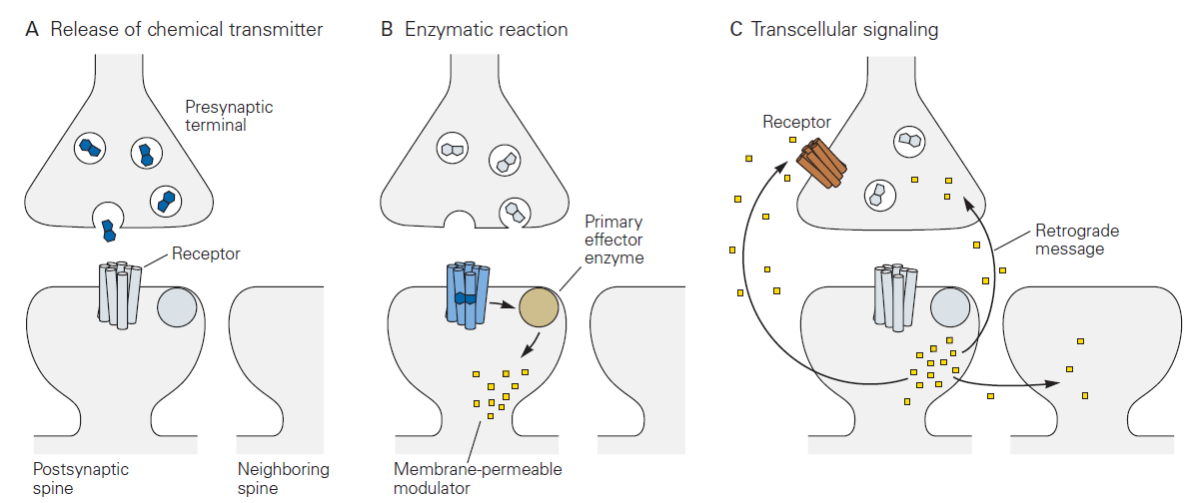

Slide 17
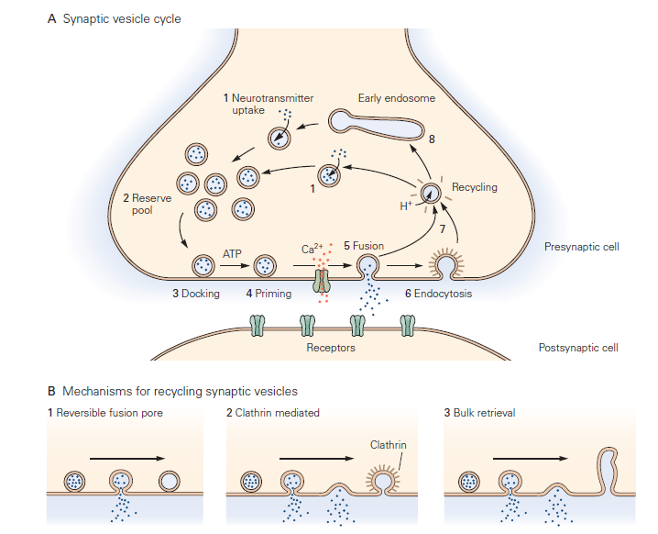

Slide 18
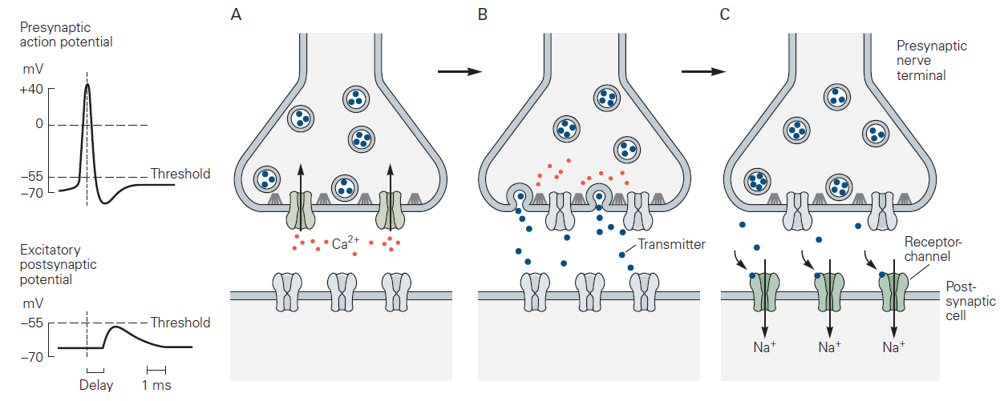

Slide 19
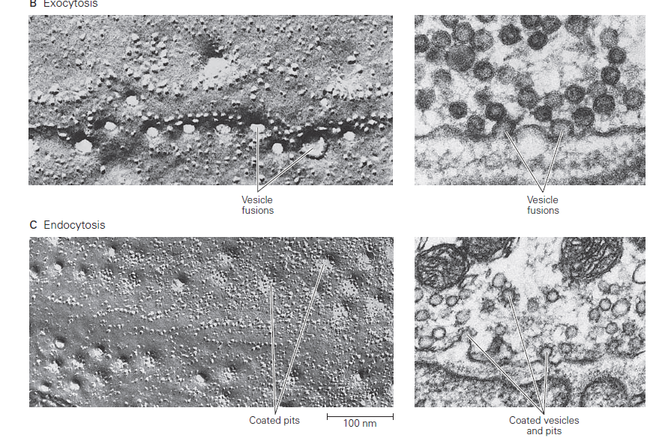

Slide 20
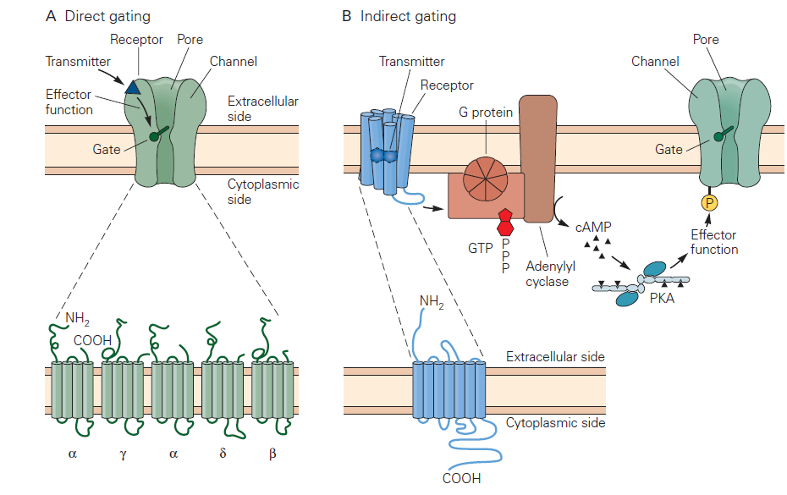

Slide 21
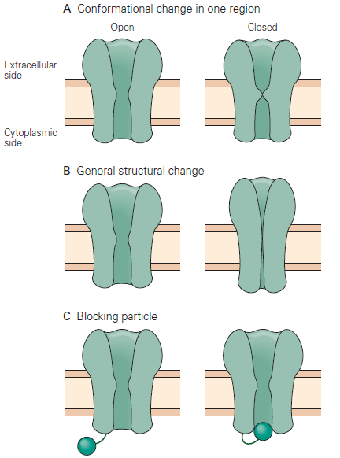

Slide 22
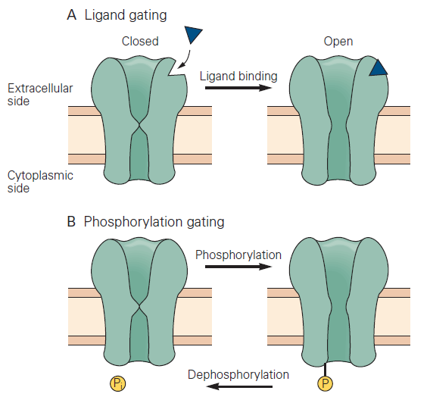
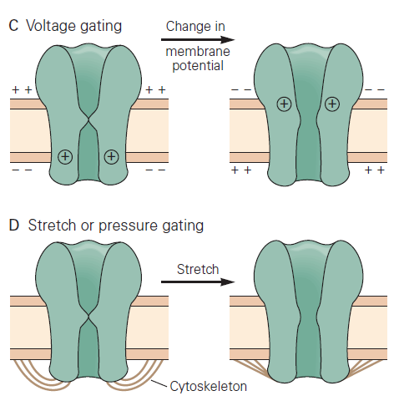

Slide 23
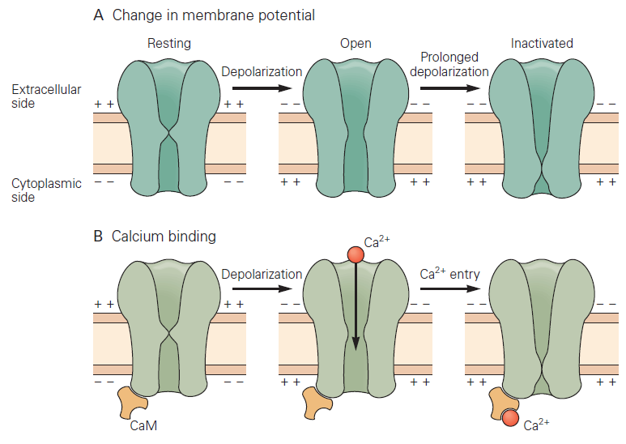

Slide 24
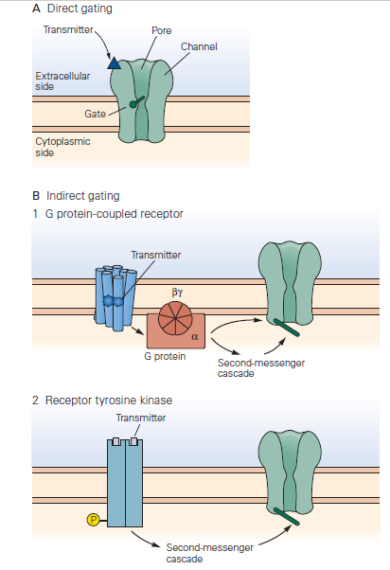

Slide 25
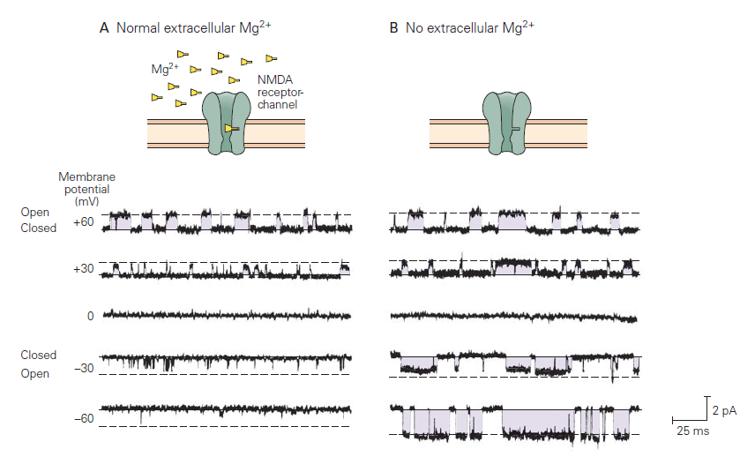

Slide 26
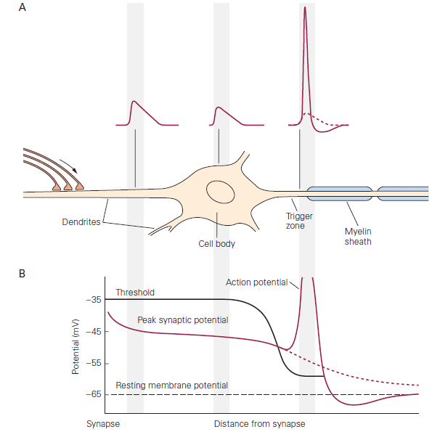

Slide 27
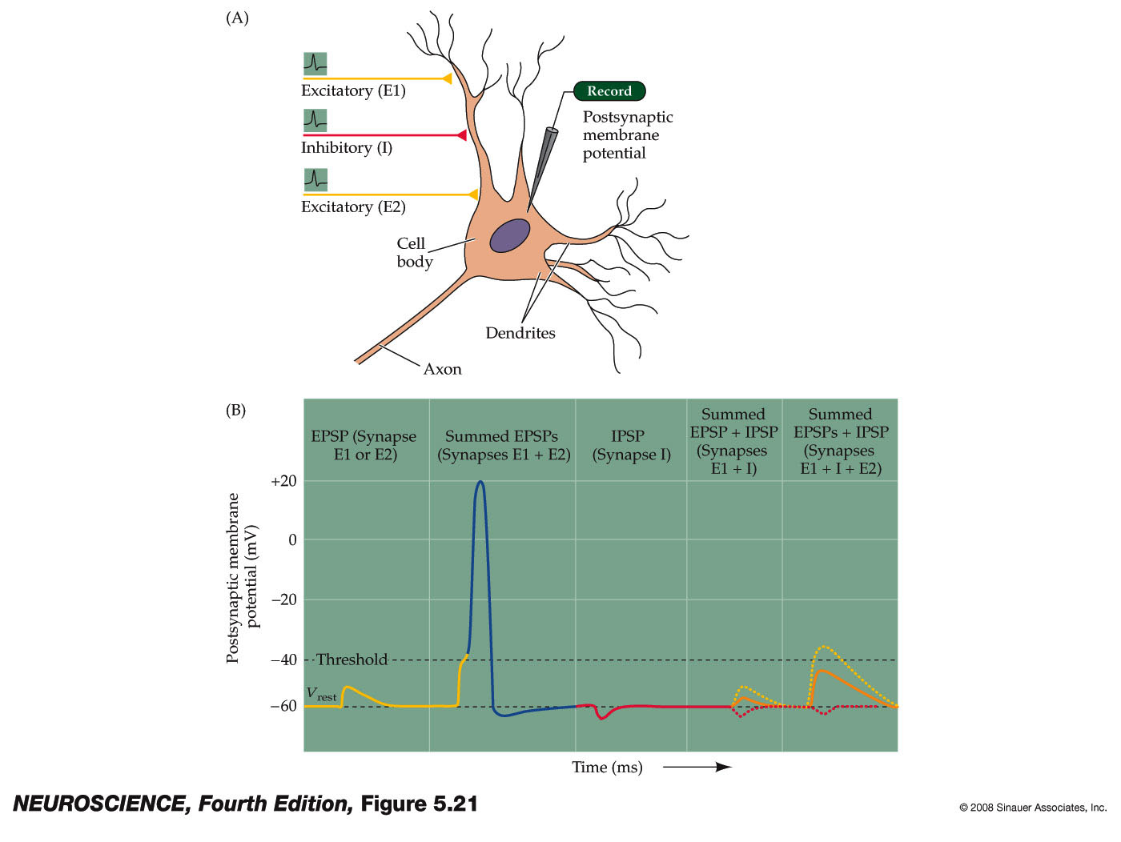

Slide 28
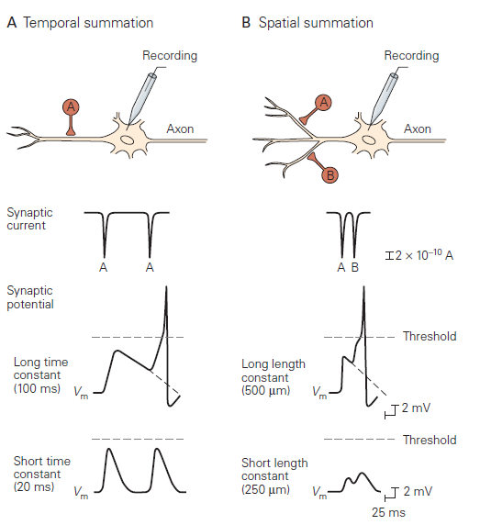

Slide 29
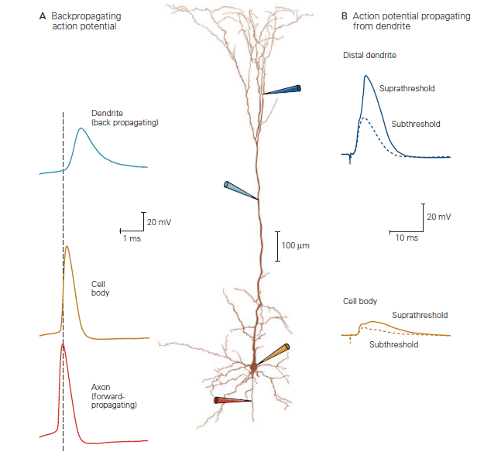

Slide 30
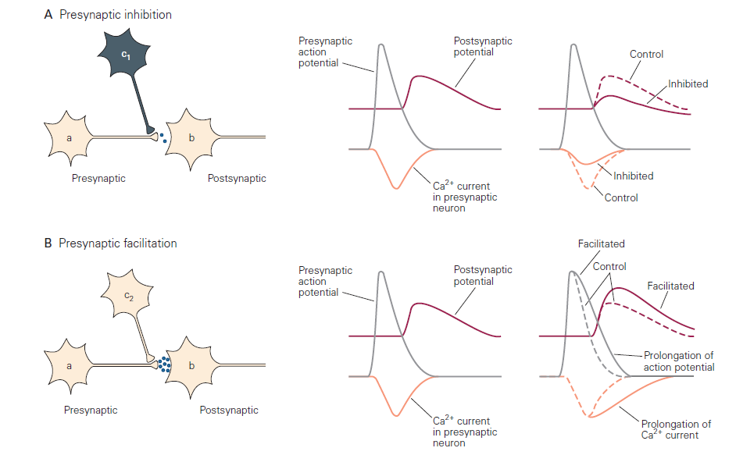

Slide 31
Neurotransmisores

Slide 32
Classic Characteristics:
Synthesized in the neuron.
Become localized in presynaptic terminal.
Bind to receptor site on postsynaptic membrane.
Removed by a specific mechanism from its specific site of action.

Slide 33
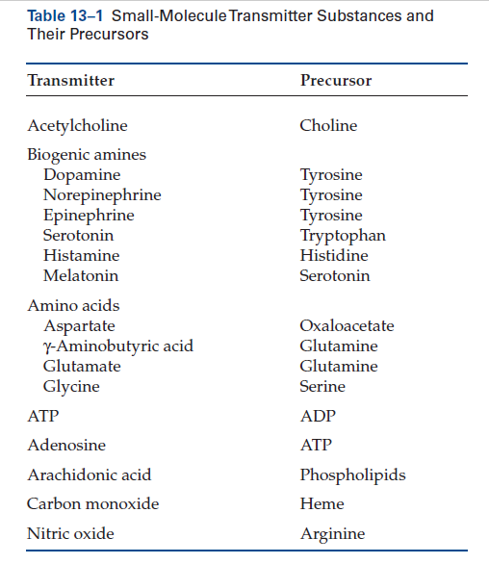

Slide 34
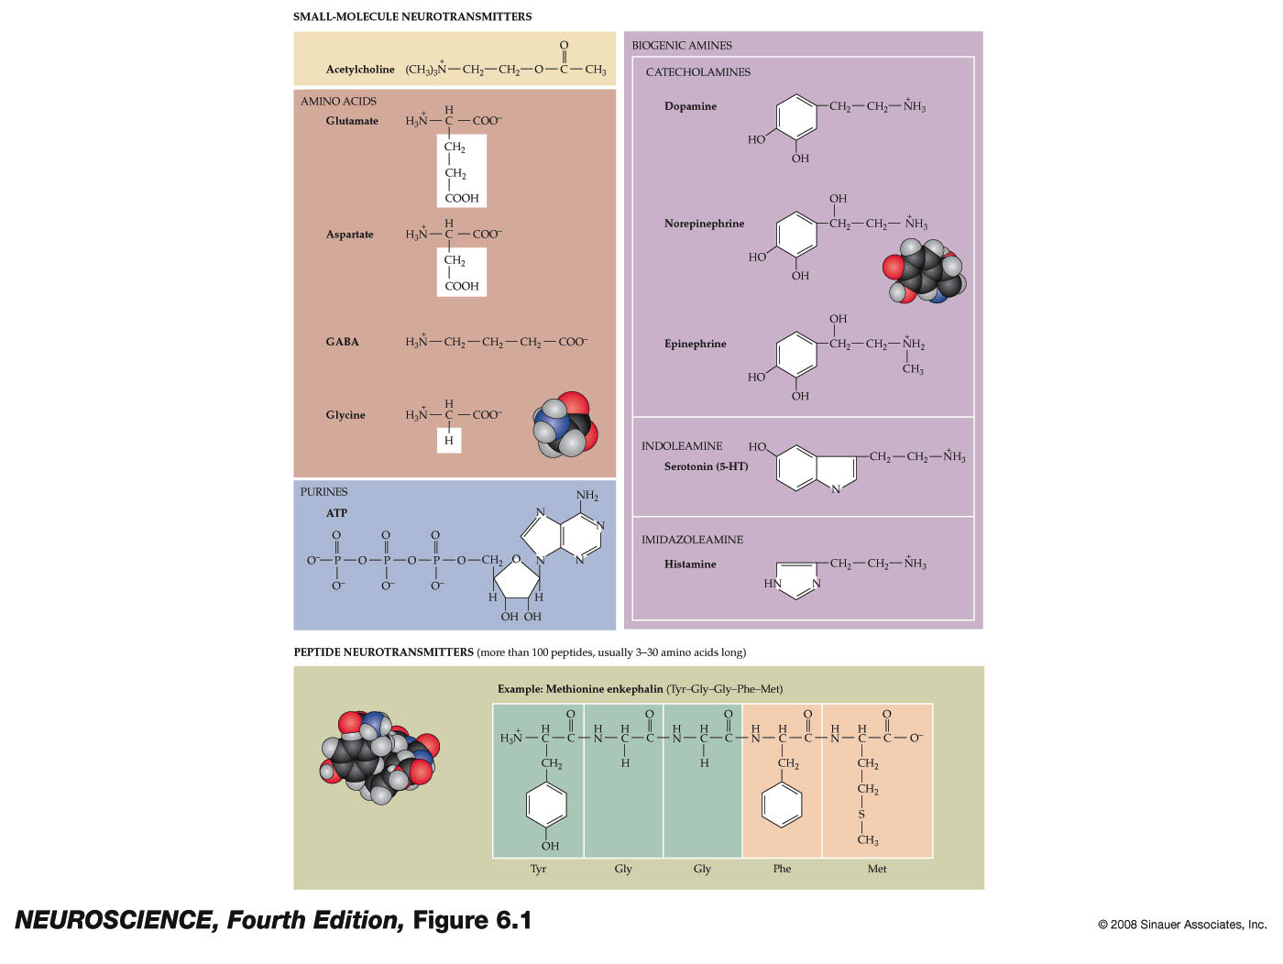

Slide 35
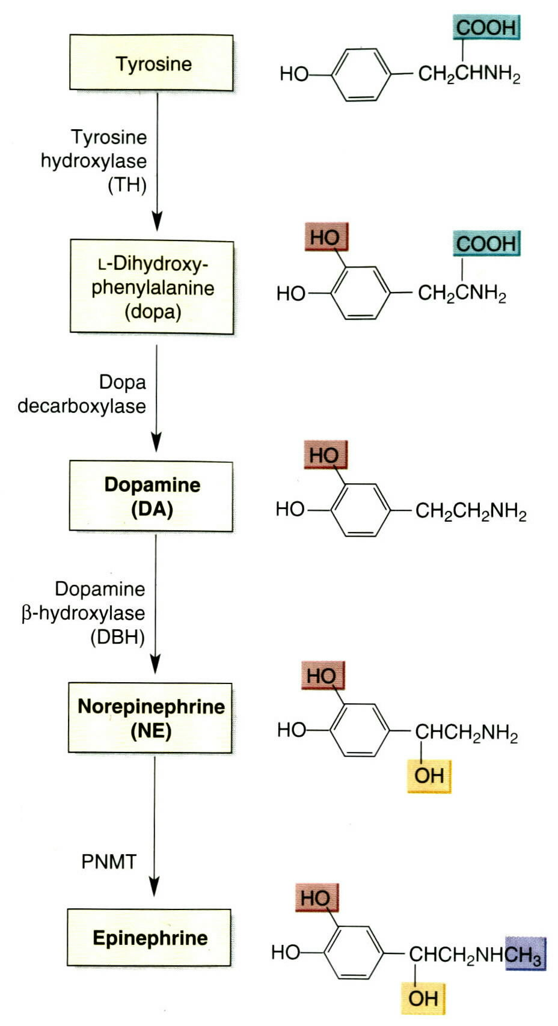
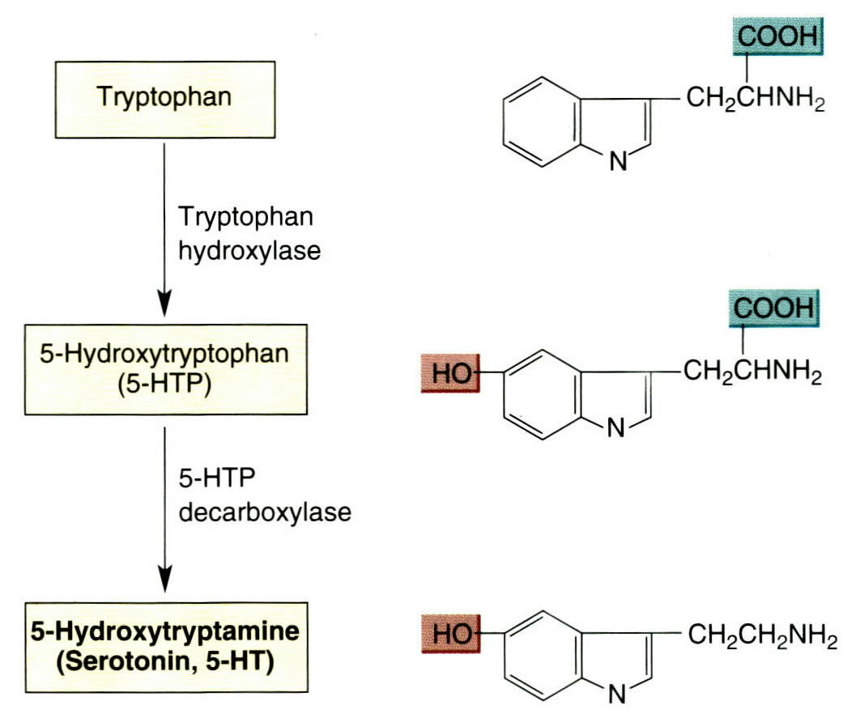
Catecholamine synthesis

Slide 36
Classification
Small molecule transmitters:
Amino acids:
Dietary amino acids.
GABA
Monoamines:
Catecholamines.
Indoleamines.
Acetylcholine.

Slide 37
Amino Acids
Dietary:
Aspartate.
Glycine.
Gamma aminobutyric acid (GABA):
From decarboxylation of glutamate.

Slide 38
Monoamines
Catecholamines:
Derived from tyrosine.
Include:
Dopamine.
Norepinephrine.
Epinephrine.

Slide 39
Monoamines
Indoleamine:
Derived from tryptophan.
Includes:
Serotonin.

Slide 40
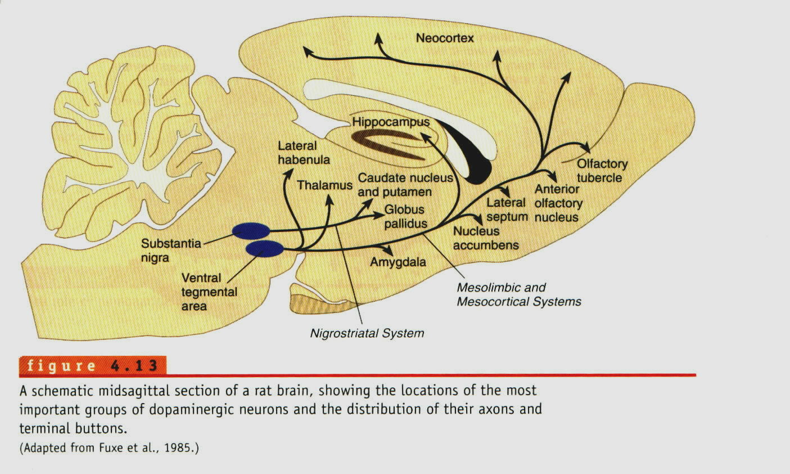

Slide 41
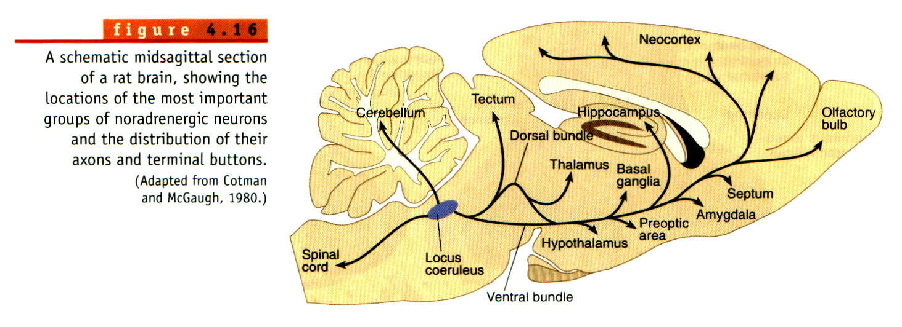

Slide 42
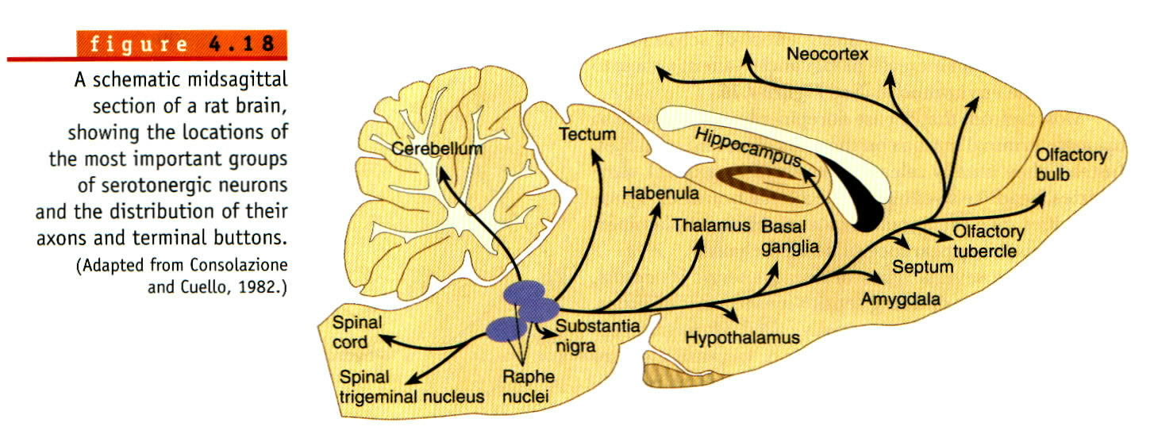
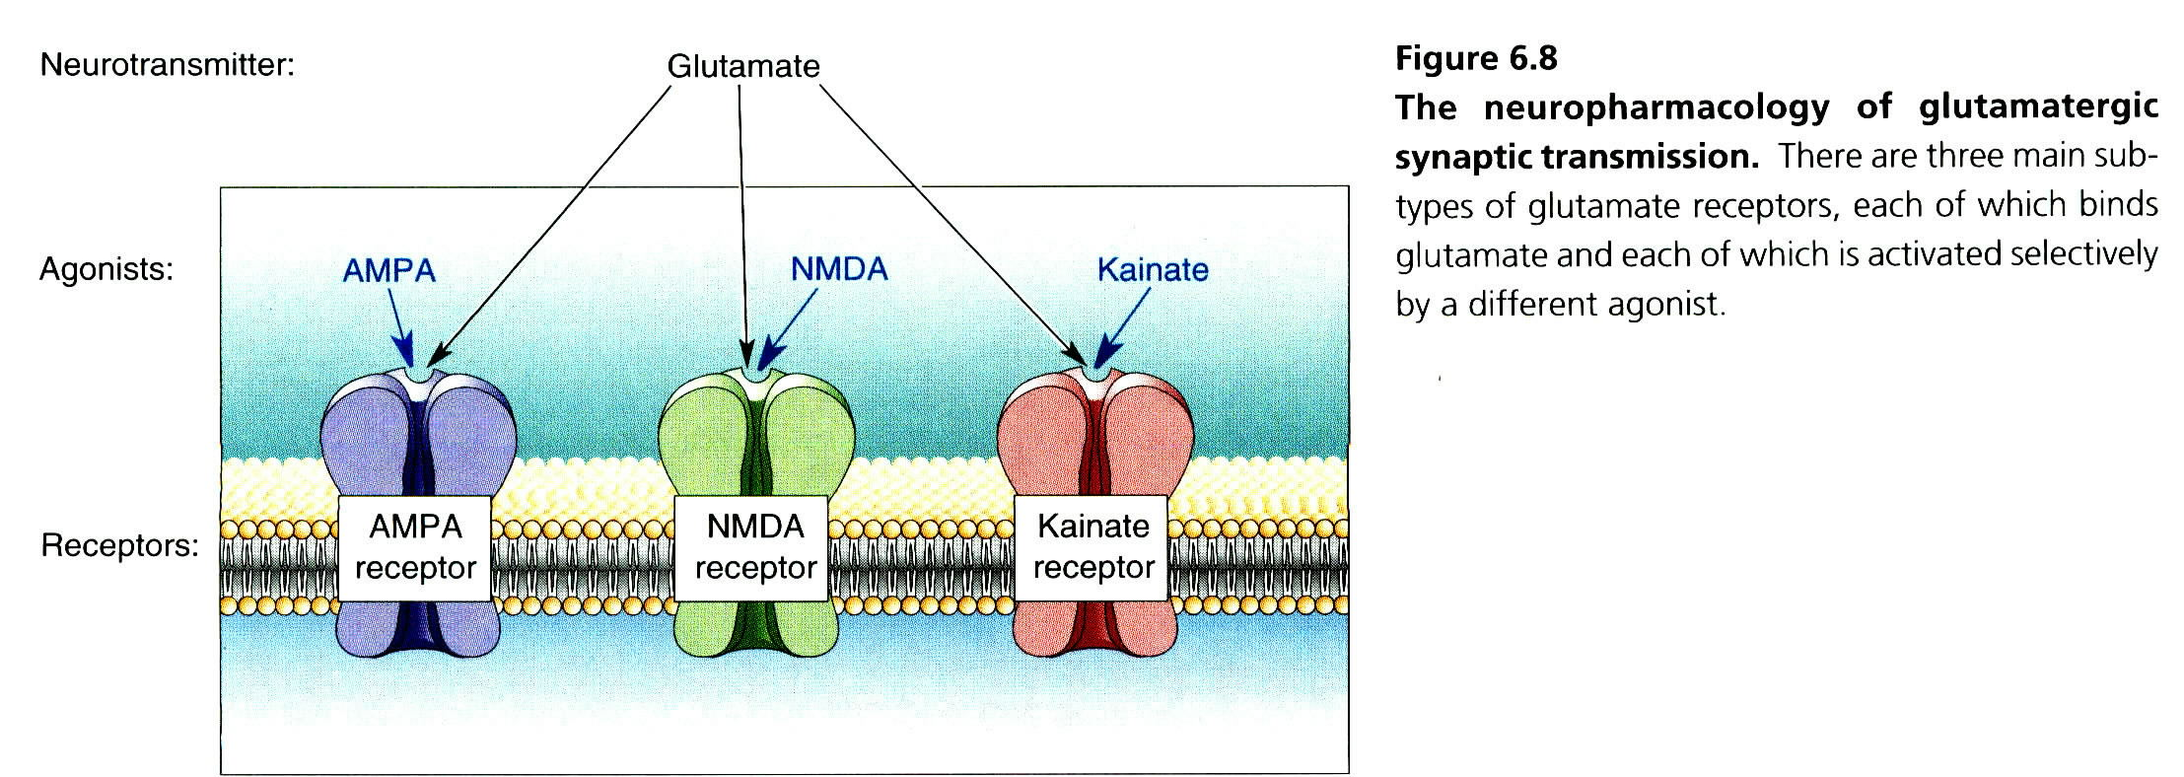
SystemsSerotonin

Slide 43
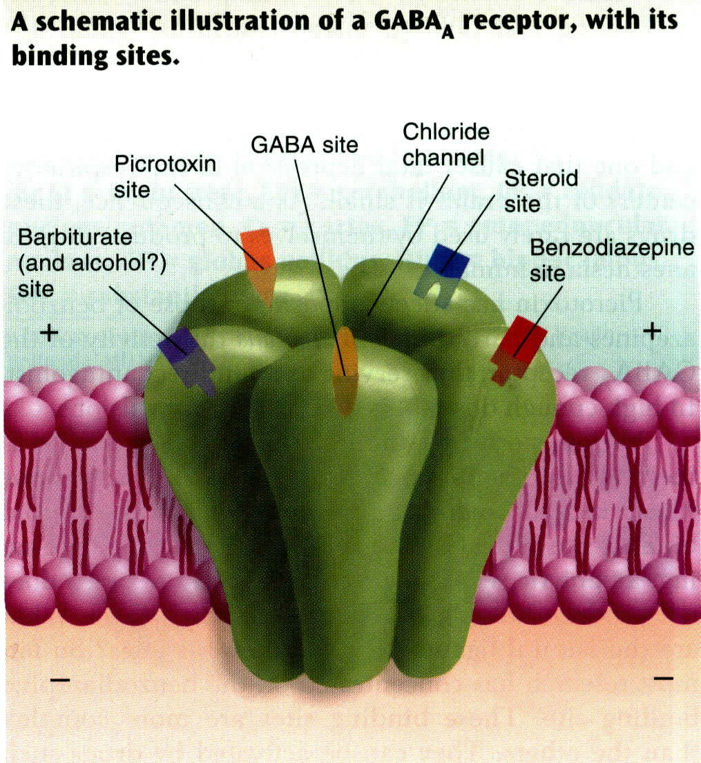
GABA receptor binding sites

Slide 44
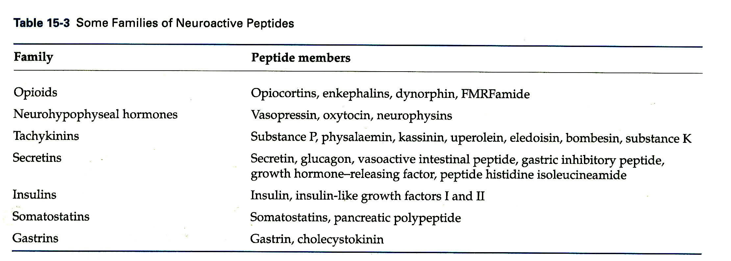

Slide 45
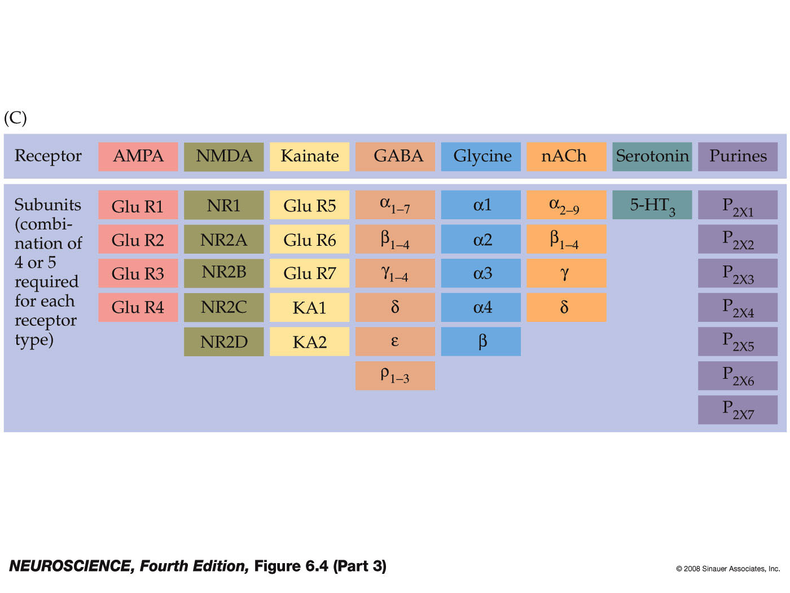

Slide 46
