Slide 1
HOW TO PROMOTE AN ENGLISH SPEAKING ENVIRONMENT AT SCHOOL

Slide 2
HOW TO PROMOTE AN ENGLISH SPEAKING ENVIRONMENT AT SCHOOL
Why did you learn english?

Slide 3
HOW TO PROMOTE AN ENGLISH SPEAKING ENVIRONMENT AT SCHOOL
Promoting a bilingual environment is one of the biggest concerns in bilingual institutions.

Slide 4
HOW TO PROMOTE AN ENGLISH SPEAKING ENVIRONMENT AT SCHOOL
WHY?
There are different reasons:

Slide 5
HOW TO PROMOTE AN ENGLISH SPEAKING ENVIRONMENT AT SCHOOL
To study in a bilingual school was not my choice; it was my parents’ decision.
It’s easier to speak my own language (L1)
The teacher always corrects me when I say something. So, I don’t want to speak because I don’t want to make a mistake in front of other people.

Slide 6
HOW TO PROMOTE AN ENGLISH SPEAKING ENVIRONMENT AT SCHOOL
It’s not ‘cool’ to speak English; it is not meaningful for me.
I don’t want to practice speaking English with people who speak my language. I only want to practice with the teacher or native speakers.

Slide 7
HOW TO PROMOTE AN ENGLISH SPEAKING ENVIRONMENT AT SCHOOL
Teachers usually want to see their students expressing their needs/opinions in formal and informal situations.

Slide 8
HOW TO PROMOTE AN ENGLISH SPEAKING ENVIRONMENT AT SCHOOL
“Yes, We Can” project was created to encourage students to enhance their English speaking capacities in everyday circumstances.

Slide 9
HOW TO PROMOTE AN ENGLISH SPEAKING ENVIRONMENT AT SCHOOL
It is necessary to encourage students to realize the language importance, creating the need to use it in different contexts on school grounds.

Slide 10
HOW TO PROMOTE AN ENGLISH SPEAKING ENVIRONMENT AT SCHOOL
The project has started to gain recognition in the school community through the following actions:
“Yes, we can” stickers which are to be placed in their agendas and counted on monthly. Every bilingual teacher has opportunity to reward students with the stickers.

Slide 11
HOW TO PROMOTE AN ENGLISH SPEAKING ENVIRONMENT AT SCHOOL
STICKERS AND BUTTONS

Slide 12
HOW TO PROMOTE AN ENGLISH SPEAKING ENVIRONMENT AT SCHOOL
In elementary school, winners names and photos are published in the school’s billboard monthly.
Periodically, winners are rewarded with presents such as: project buttons, ice creams, books, school supplies, certificates, etc.
The most meaningful motivation for students is to receive at the end of the school year a very significant prize..

Slide 13
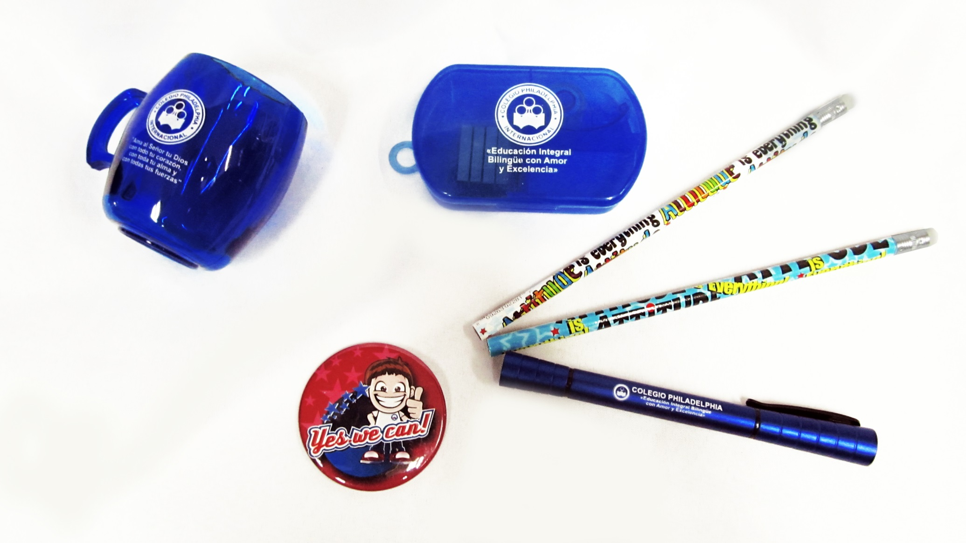
HOW TO PROMOTE AN ENGLISH SPEAKING ENVIRONMENT AT SCHOOL

Slide 14
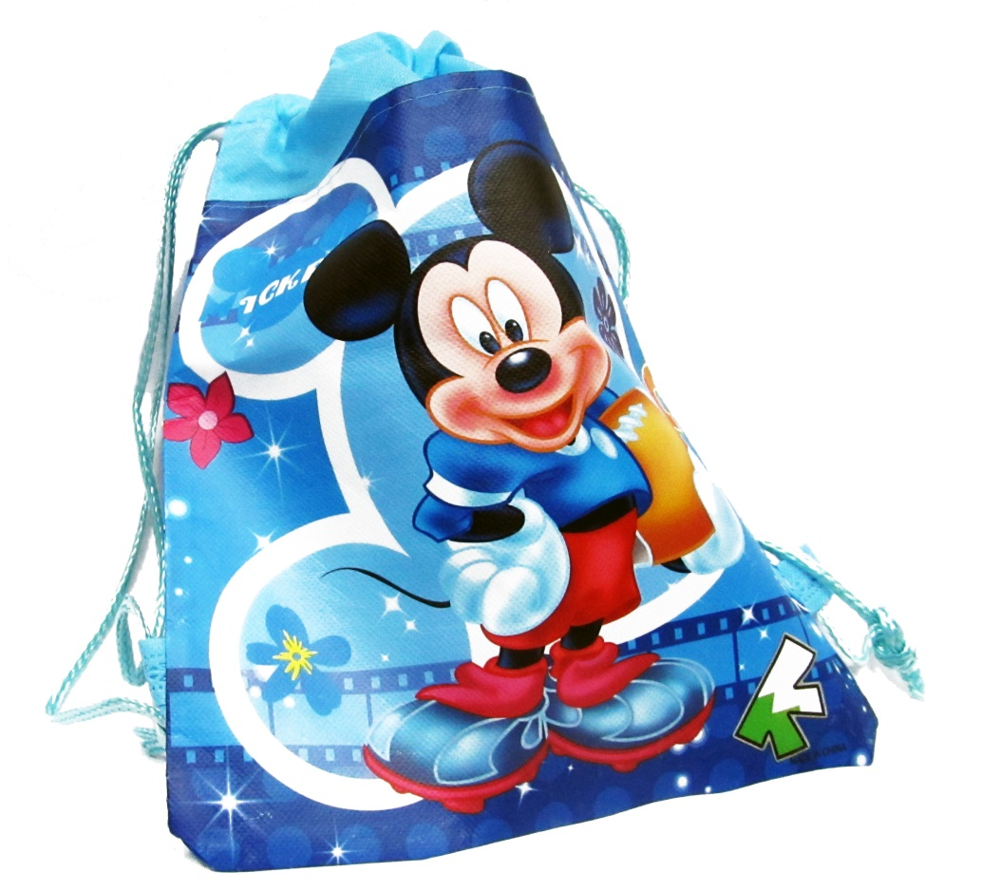
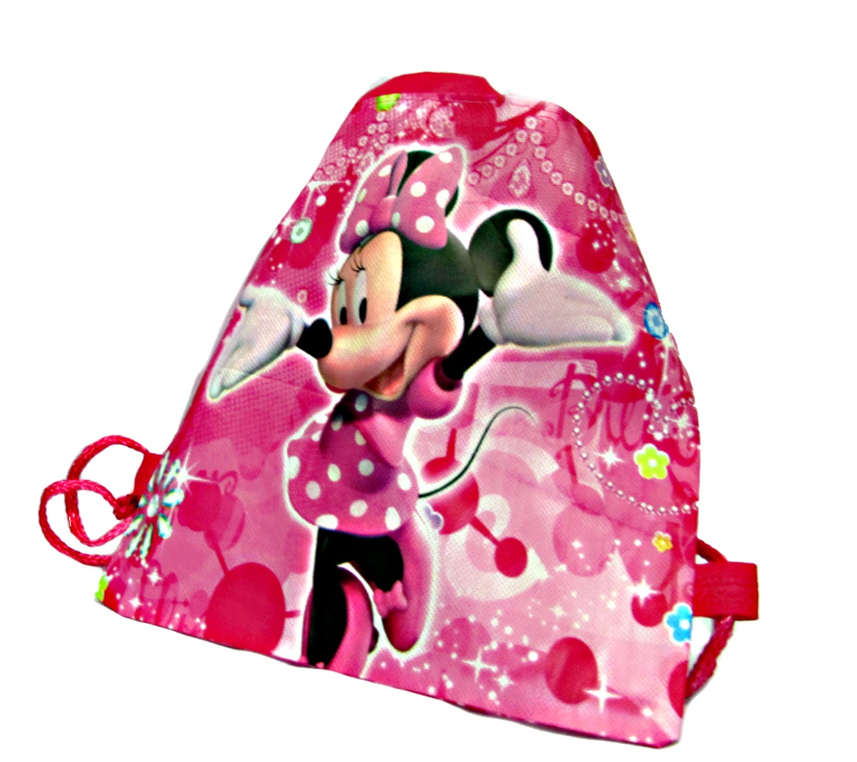
HOW TO PROMOTE AN ENGLISH SPEAKING ENVIRONMENT AT SCHOOL

Slide 15
HOW TO PROMOTE AN ENGLISH SPEAKING ENVIRONMENT AT SCHOOL

Slide 16
HOW TO PROMOTE AN ENGLISH SPEAKING ENVIRONMENT AT SCHOOL
Teachers are expected to have an attitude of willingness and be receptive to corrections. They must also evaluate their role as model of the second language for the students regularly. Teachers’ continuous effort to encourage students is recognized with certificates.

Slide 17
HOW TO PROMOTE AN ENGLISH SPEAKING ENVIRONMENT AT SCHOOL
TESTIMONIES

Slide 18
HOW TO PROMOTE AN ENGLISH SPEAKING ENVIRONMENT AT SCHOOL
IMPORTANT FACTS /RESULTS:
All students have the opportunity to win, not only the “good” ones.
Increases self-confidence.
Promotes positive attitudes towards the second language.

Slide 19
HOW TO PROMOTE AN ENGLISH SPEAKING ENVIRONMENT AT SCHOOL
Strengthens teacher-student relationship.
Improves academic performance in L2 classes.
Fosters creativity and participation.

Slide 20
HOW TO PROMOTE AN ENGLISH SPEAKING ENVIRONMENT AT SCHOOL
IDEAS…
Create a “special character” (Philip)
Sales to get money and buy prizes
Ask support to different departments: Asofamilia, Printing Houses, etc.

Slide 21
HOW TO PROMOTE AN ENGLISH SPEAKING ENVIRONMENT AT SCHOOL
Motivation is one of the most effective means to promote an English speaking environment.

Slide 22
HOW TO PROMOTE AN ENGLISH SPEAKING ENVIRONMENT AT SCHOOL
Adarley Manrique
Ana Milena Holguín
Ángela Hernández
Carolina Montaño
Carolina Reinis
Germán Valdez
Guillermo Mafla
Hector Bianchá
Indira Soto
Jaime Alberto Valencia
Javier Hernández
Jhohanna Idárraga
Jhon Jairo Ordoñez
Jhon Polanía
Laura Ramos
Leonardo Moreno
Luis Felipe Reyes
Luz Erika Orjuela
Luz Jenny Vivas
Luz Marina Ceballos
Luzcelly Trochez
Marco A. Montoya
Marlon Chamorro
Mónica Viedma
Nelson Rivera
Olga Lucia Quintero
Paola Chica
Paula García
Robinson Fernández
Sandra Mendoza

Slide 23
HOW TO PROMOTE AN ENGLISH SPEAKING ENVIRONMENT AT SCHOOL
THANK YOU!
JHOHANNA IDÁRRAGA jidarraga@philadelphiainternacional.edu.co
”Whatever work you do, do it with all your heart.
Do it for the Lord and not for men.”

