Slide 1

LITERATURE CIRCLES, A WAY TO EXPLORE DIFFERENT CULTURES
JENNYFER HOMEZ SABOGAL
LANGUAGE CENTER
UNIVERSIDAD
LA GRAN COLOMBIA

Slide 2
AGENDA
Introduction
Samples
Activity

Slide 3
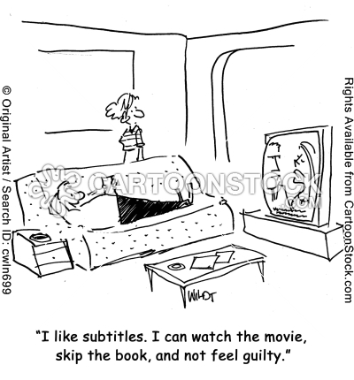

Slide 4
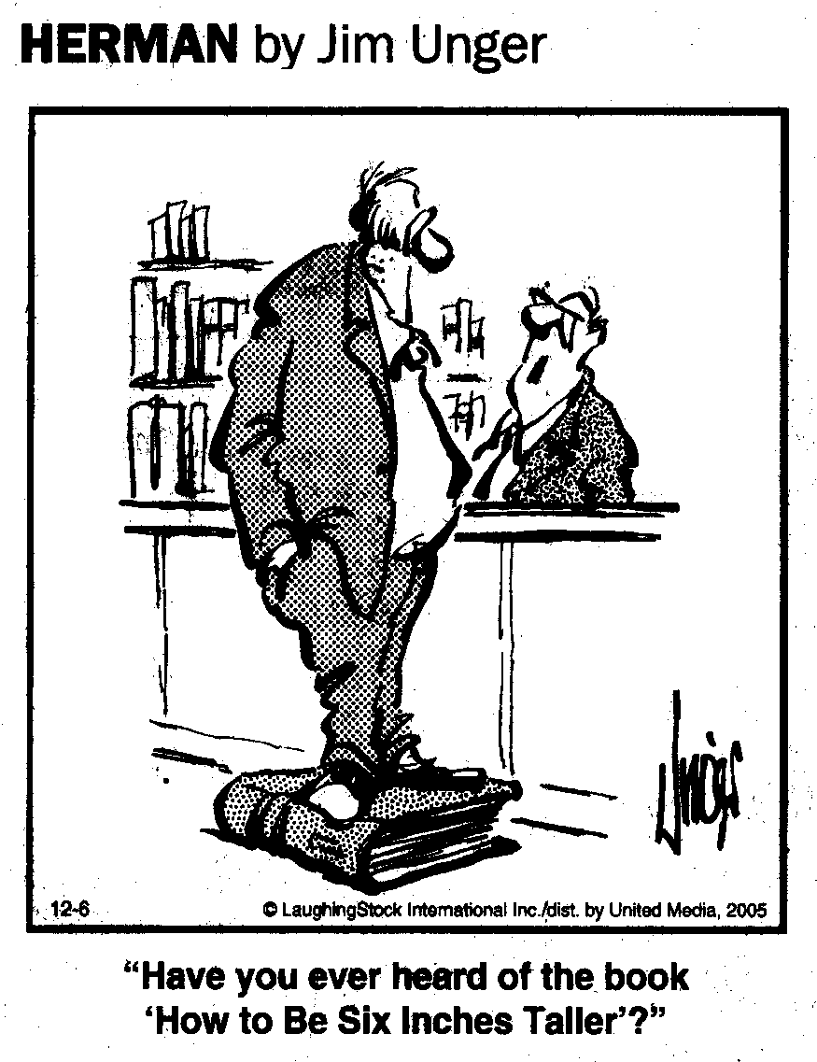

Slide 5
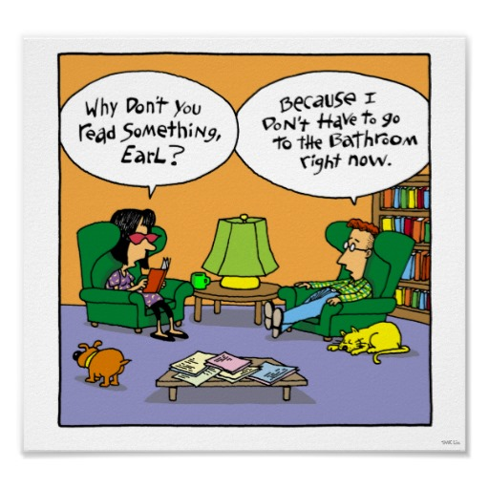

Slide 6
A literature circle is a students' equivalent of an adult book club, but with greater structure, expectation and rigor. The aim is to encourage thoughtful discussion and a love of reading in young people. The true intent of literature circles is "to allow students to practice and develop the skills and strategies of good readers" (DaLie, 2001).

Slide 7
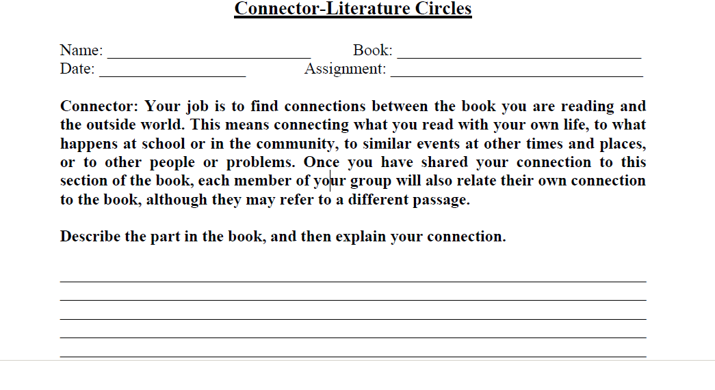

Slide 8
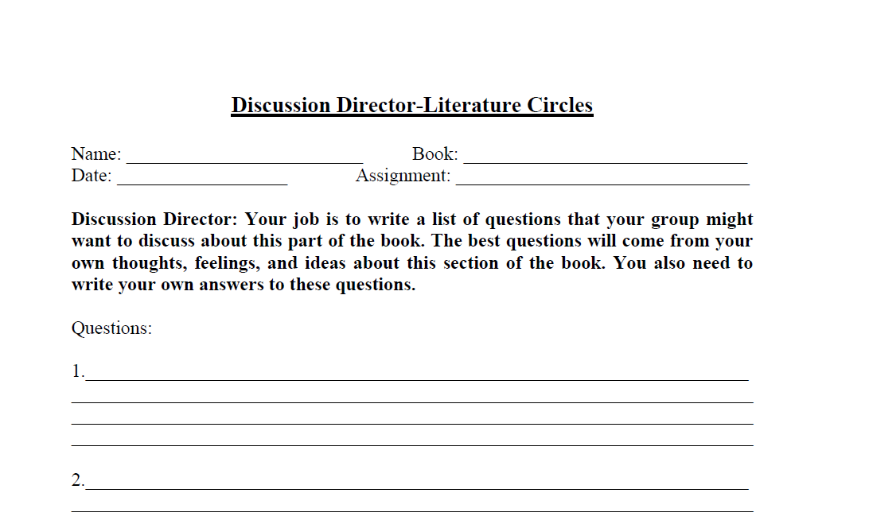

Slide 9
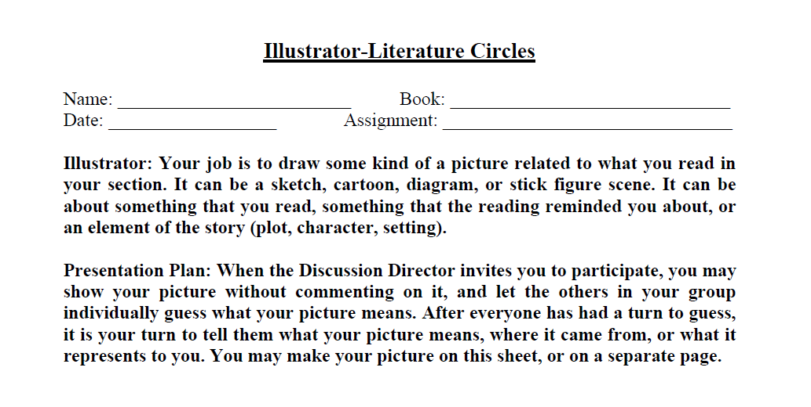

Slide 10
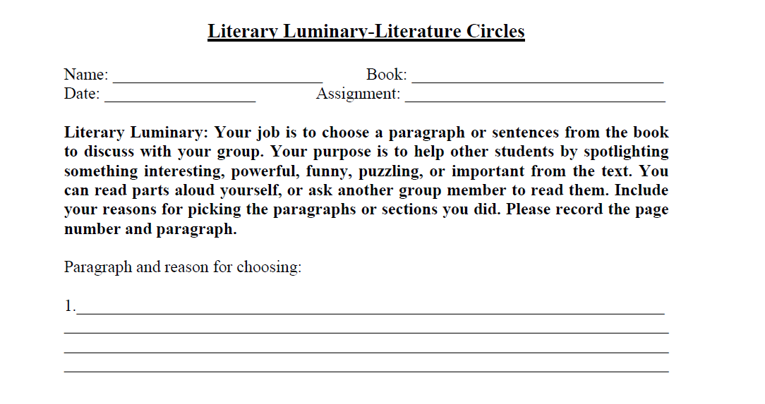

Slide 11
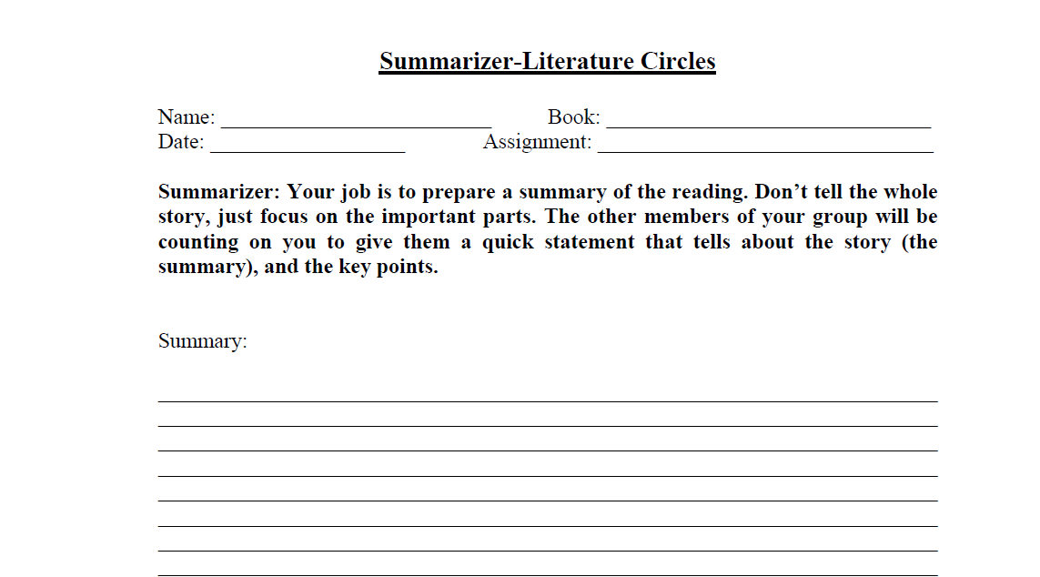

Slide 12
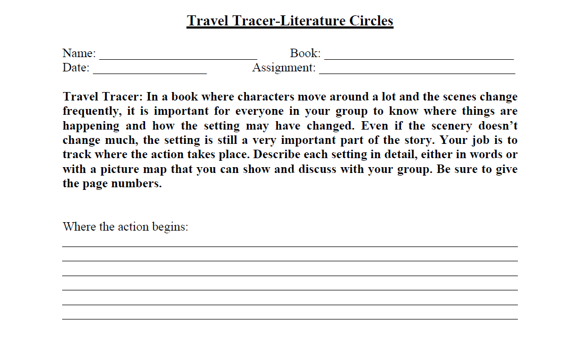

Slide 13
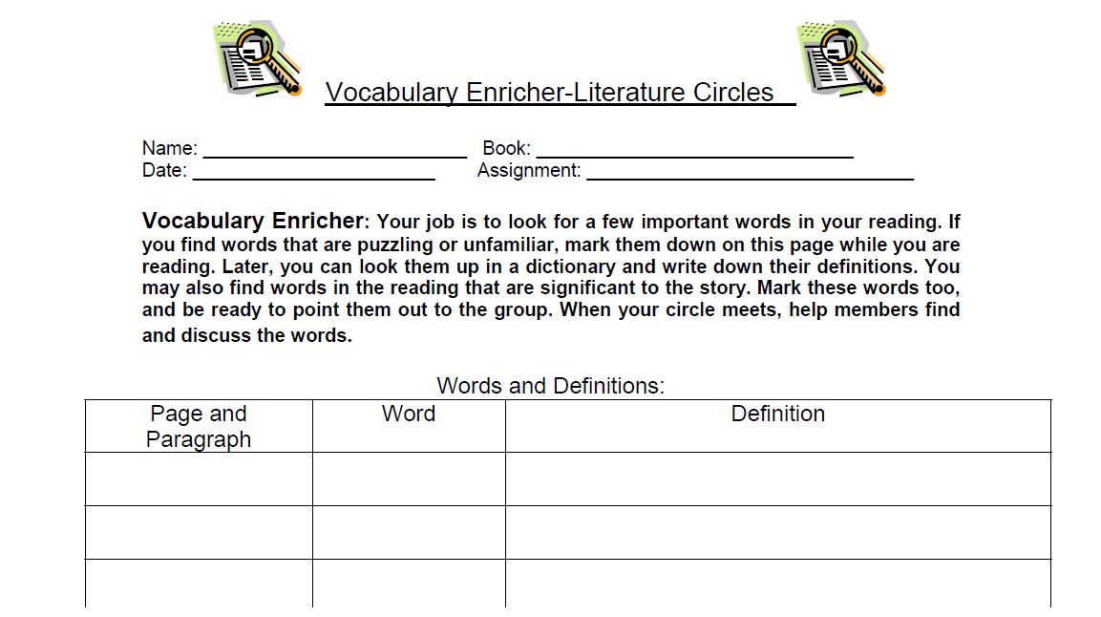

Slide 14
LANGUAGE CENTER
UNIVERSIDAD
LA GRAN COLOMBIA JENNYFER HOMEZ SABOGAL
jennyfer.homez@ugc.edu.co

